Slide 1
Wave Learning Turn Data into Insight and Actions Deep Learning Artificial Neural Network (ANN)
Larry Huang, Jeffrey Huang

Slide 2
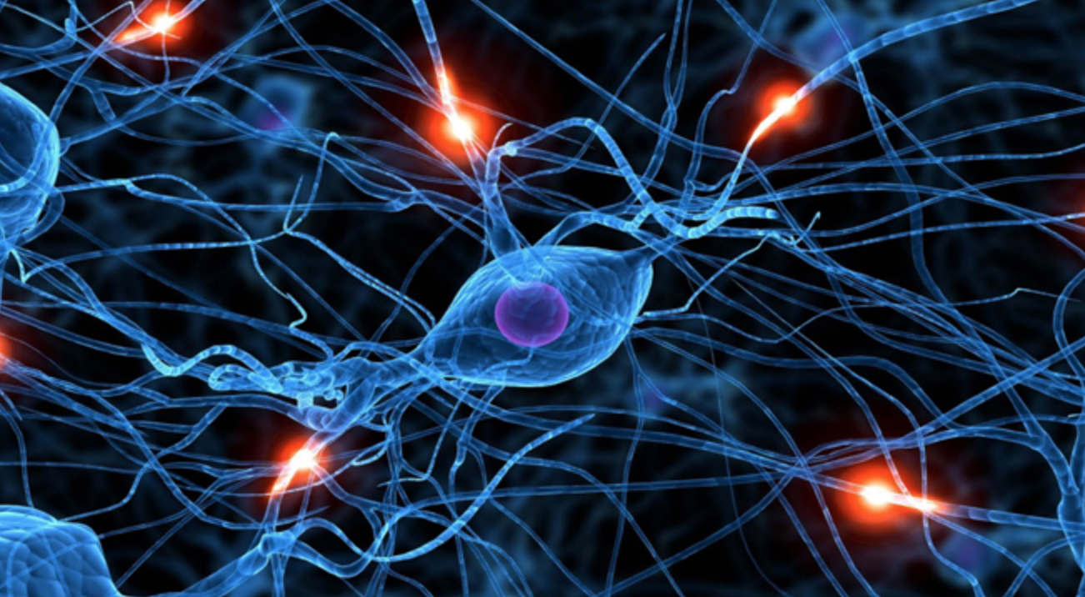
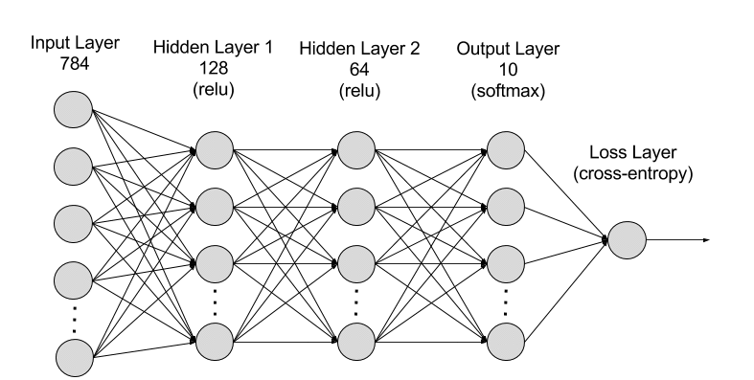
Motivation: Biological Neural Network
Learn like human brain
100 billion Neurons in human brain
Notes:
Computer vision (face recognition), NLP(sentiment analysis based on twitter, forum), game play(DeepBlue, AlphaGo),

Slide 3
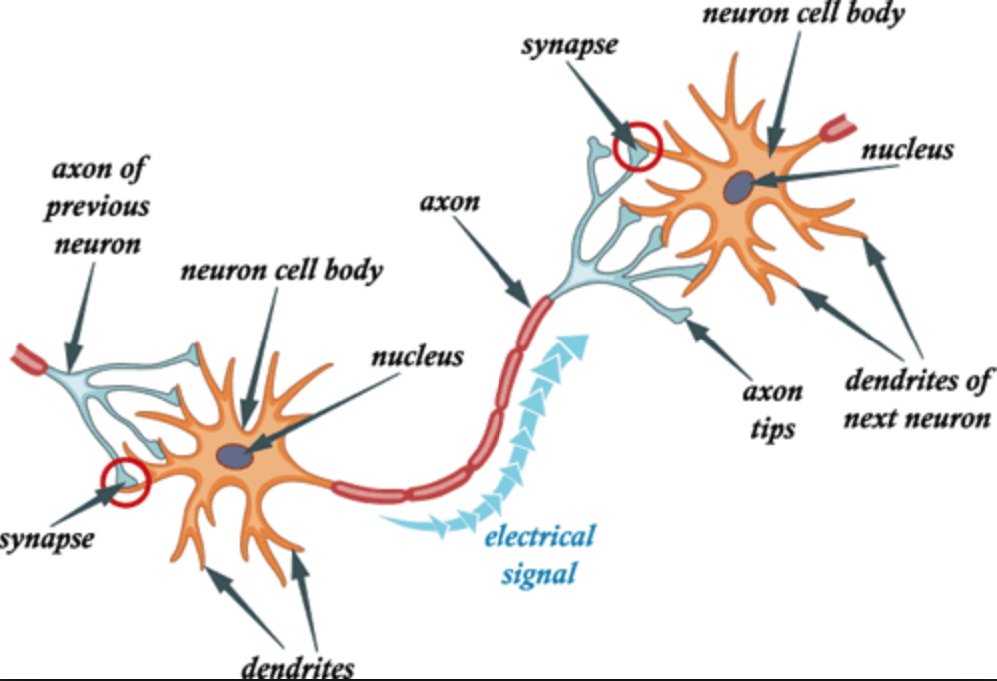
Motivation: Biological Neuron
Notes:
Computer vision (face recognition), NLP(sentiment analysis based on twitter, forum), game play(DeepBlue, AlphaGo),

Slide 4
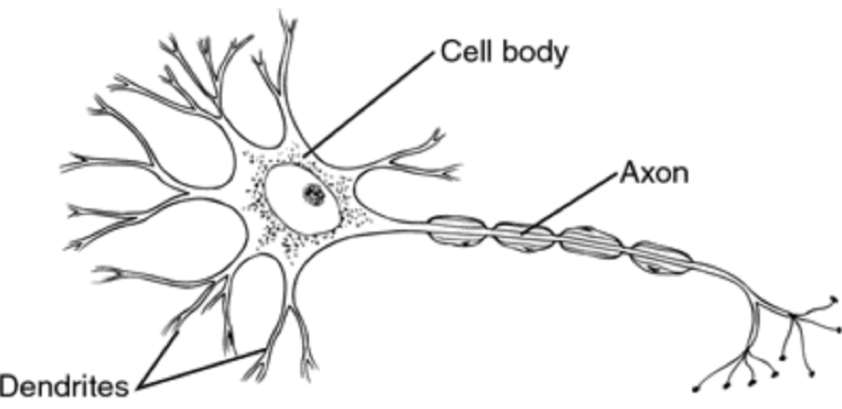
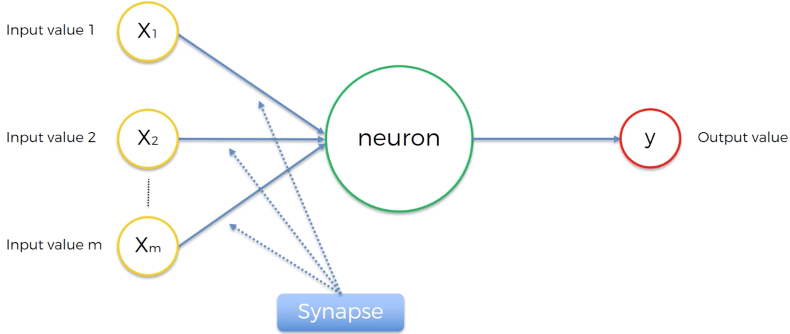
Biological Neuron vs Artificial Neuron
Neuron:
Perceptron:
Notes:
Computer vision (face recognition), NLP(sentiment analysis based on twitter, forum), game play(DeepBlue, AlphaGo),

Slide 5
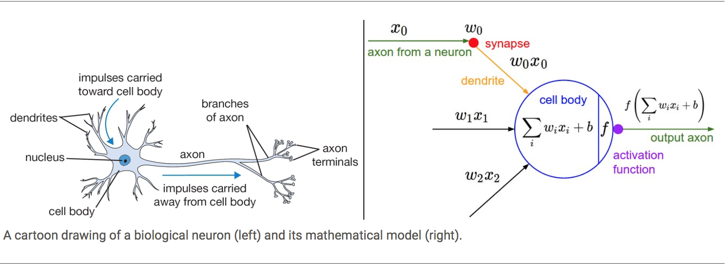
Biological Neuron versus Artificial Neural Network
Notes:
Computer vision (face recognition), NLP(sentiment analysis based on twitter, forum), game play(DeepBlue, AlphaGo),

Slide 6
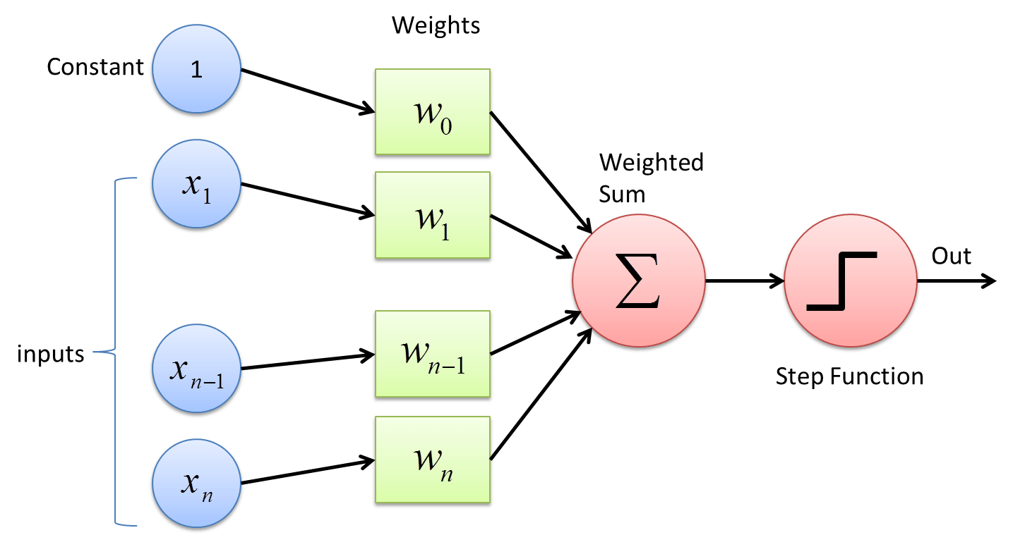
From Neuron To Perceptron
Neuron:
Perceptron:
Notes:
Computer vision (face recognition), NLP(sentiment analysis based on twitter, forum), game play(DeepBlue, AlphaGo),

Slide 7
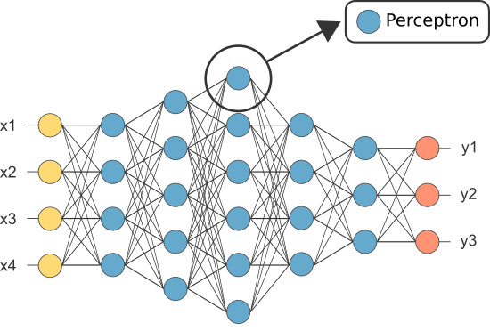
Multilayer Perceptron Network (MLP)
Notes:
Computer vision (face recognition), NLP(sentiment analysis based on twitter, forum), game play(DeepBlue, AlphaGo),

Slide 8
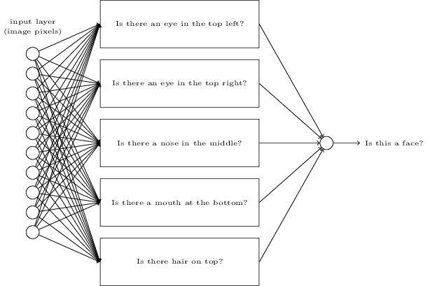
Why many artificial neurons?
Notes:
Computer vision (face recognition), NLP(sentiment analysis based on twitter, forum), game play(DeepBlue, AlphaGo),

Slide 9
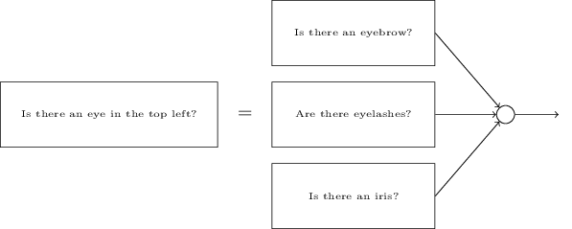
Why many layers?
Notes:
Computer vision (face recognition), NLP(sentiment analysis based on twitter, forum), game play(DeepBlue, AlphaGo),

Slide 10
Why Deep Learning?
What we learning before are “shallow” machine learning methods
The primary reason is that Deep Learning makes problem solving much easier by completely automating the most crucial step in a Machine Learning workflow: Feature Engineering
Also, with Deep Learning, all the layers are learned jointly, which is way better than stacking multiple “shallow” learning methods where each method is learned independently
Notes:
Computer vision (face recognition), NLP(sentiment analysis based on twitter, forum), game play(DeepBlue, AlphaGo),

Slide 11
Not A New Thing!
Was invented in 1940s
First AI Winter in 1960s
ANN overtaken by Decision Trees and other machine learning methods
Second AI Winter in 1990s
ANN was able to recognize handwritten digits (used by USPS)
ANN overtaken by SVM and other kernel machine learning methods
Right now is the third AI hype. Why?
Hardware advances
Bigger and better datasets
Algorithmic advances
Notes:
Computer vision (face recognition), NLP(sentiment analysis based on twitter, forum), game play(DeepBlue, AlphaGo),

Slide 12
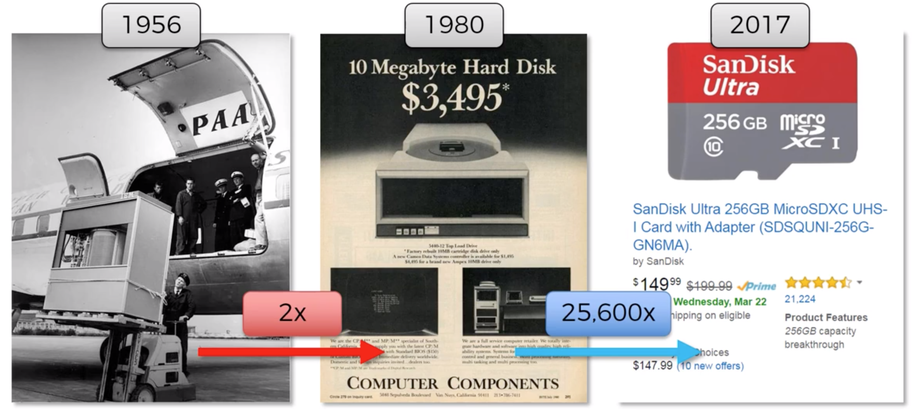
Bigger and Better Storage
In 1956, $2500 to rent 5MB hard drive for one month
Notes:
Computer vision (face recognition), NLP(sentiment analysis based on twitter, forum), game play(DeepBlue, AlphaGo),

Slide 13
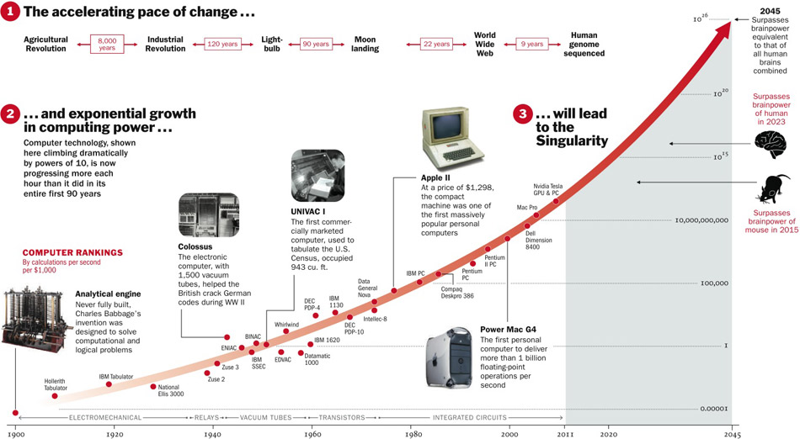
Computational Calculations per second per $1000
Notes:
Computer vision (face recognition), NLP(sentiment analysis based on twitter, forum), game play(DeepBlue, AlphaGo),

Slide 14
GPU (Graphical Processing Unit)
NVIDIA and AMD have been investing billions of dollars in developing fast, massively parallel chips (GPU)—cheap, single-purpose supercomputers designed to render complex computer games in real time
Deep neural networks, consisting mostly of many small matrix multiplications, are also highly parallelizable
In 2007, NVIDIA launched CUDA (https://developer.nvidia.com/about-cuda), a programming interface for its line of GPUs, allowing research and commercial communities to use GPU to train deep neural networks
Notes:
Computer vision (face recognition), NLP(sentiment analysis based on twitter, forum), game play(DeepBlue, AlphaGo),

Slide 15
Better Algorithms
The advent of several simple but important algorithmic improvements that allowed for better gradient propagation:
Better activation functions for neural layers
Better weight-initialization schemes
Better optimization schemes (gradient descent), such as RMSProp and Adam
Only when these improvements began to allow for training models with 10 or more layers did deep learning start to shine.
Even more advanced ways in 2014/2015/2016 was discovered to help gradient propagation. Today we can train from scratch models that are thousands of layers deep.
Notes:
Computer vision (face recognition), NLP(sentiment analysis based on twitter, forum), game play(DeepBlue, AlphaGo),

Slide 16
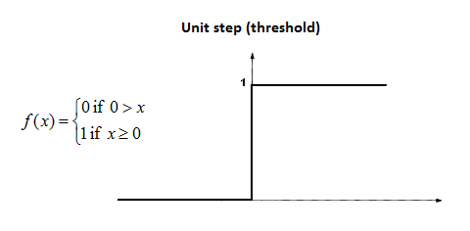
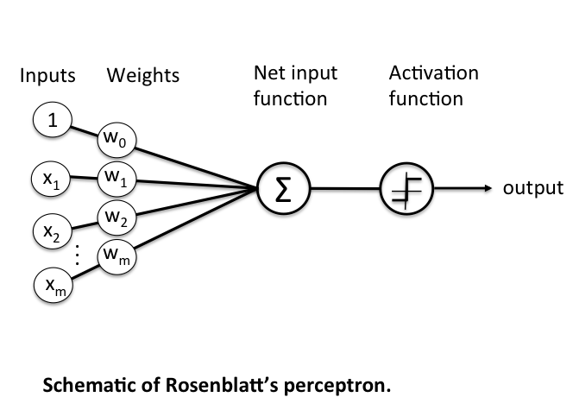
Threshold Activation Function
Basic Perceptron (Rosenblatt Perceptron)
Threshold function
Notes:
Computer vision (face recognition), NLP(sentiment analysis based on twitter, forum), game play(DeepBlue, AlphaGo),

Slide 17

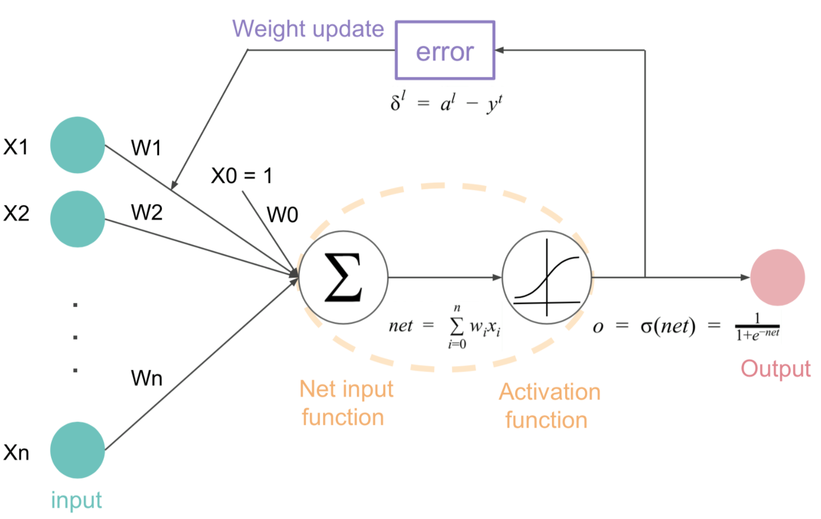
Sigmoid Activation Function
Logistic Regression Perceptron
Notes:
Computer vision (face recognition), NLP(sentiment analysis based on twitter, forum), game play(DeepBlue, AlphaGo),

Slide 18
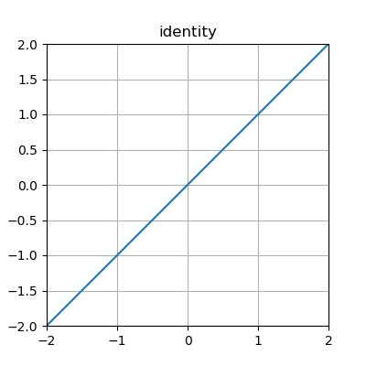
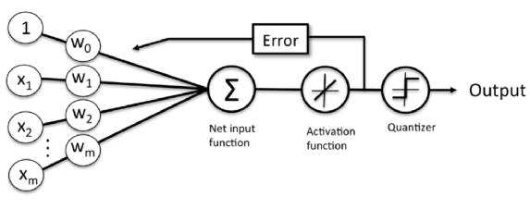
Identity Activation Function
Linear Regression Perceptron
Notes:
Computer vision (face recognition), NLP(sentiment analysis based on twitter, forum), game play(DeepBlue, AlphaGo),

Slide 19
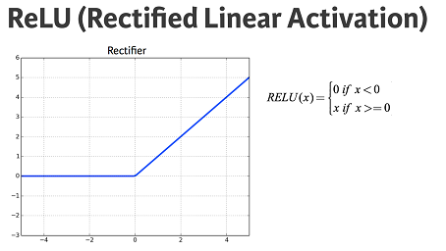
Rectifier Activation Function
Notes:
Computer vision (face recognition), NLP(sentiment analysis based on twitter, forum), game play(DeepBlue, AlphaGo),

Slide 20
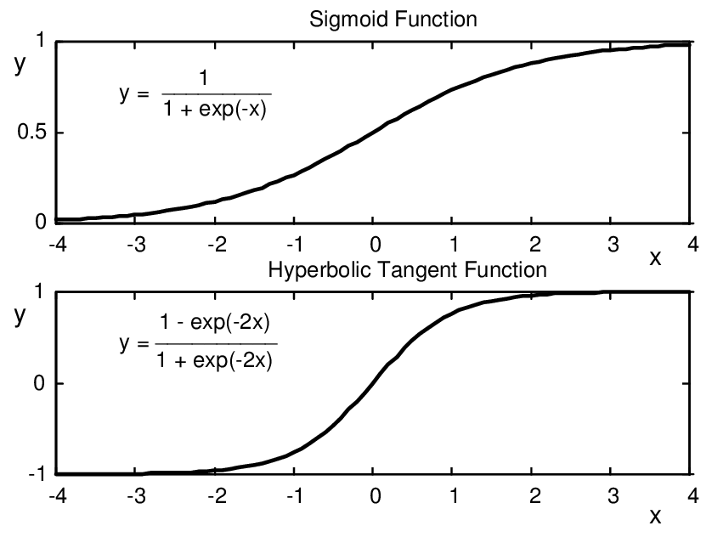
Hyperbolic Tangent (Tanh) Activation Function
Notes:
Computer vision (face recognition), NLP(sentiment analysis based on twitter, forum), game play(DeepBlue, AlphaGo),

Slide 21
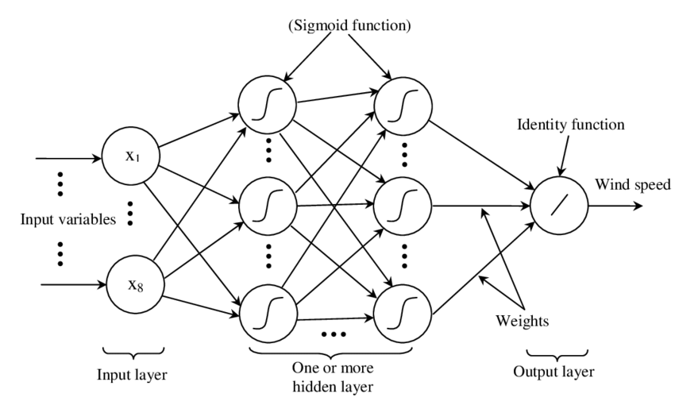
Neural Network
Notes:
Computer vision (face recognition), NLP(sentiment analysis based on twitter, forum), game play(DeepBlue, AlphaGo),

Slide 22
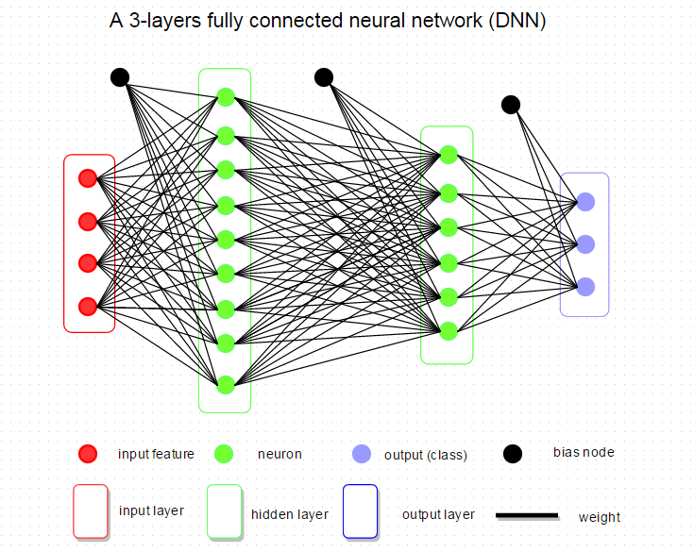
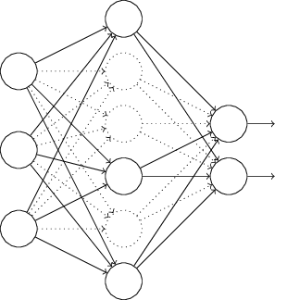
Dense Layer
Also known as: Fully Connected Layer
Notes:
Computer vision (face recognition), NLP(sentiment analysis based on twitter, forum), game play(DeepBlue, AlphaGo),

Slide 23
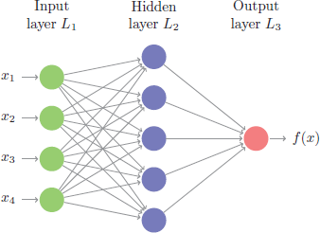
Feedforward Neural Network
Feedforward Neural Network
No loops in the network
Information is always fed forward, never fed back
Deep Feedforward Neural Network
Notes:
Computer vision (face recognition), NLP(sentiment analysis based on twitter, forum), game play(DeepBlue, AlphaGo),

Slide 24
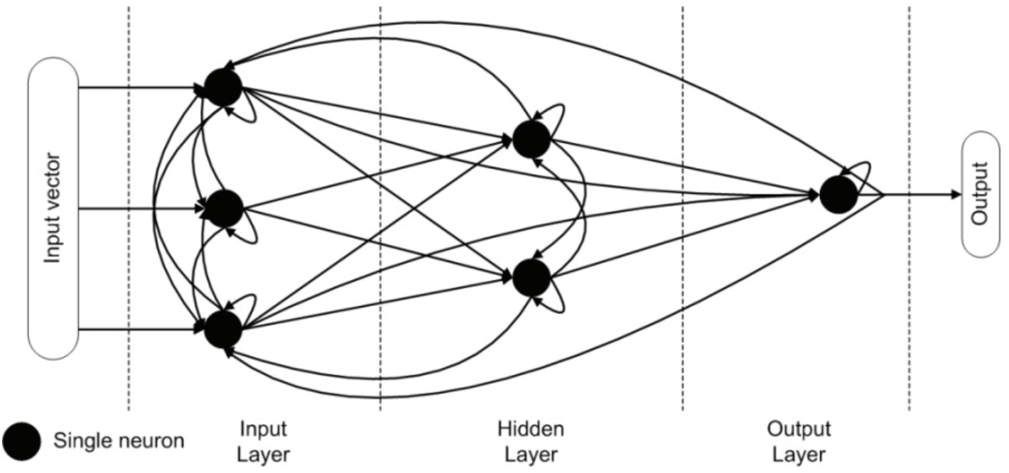
Recursive Neural Network
Notes:
Computer vision (face recognition), NLP(sentiment analysis based on twitter, forum), game play(DeepBlue, AlphaGo),

Slide 25
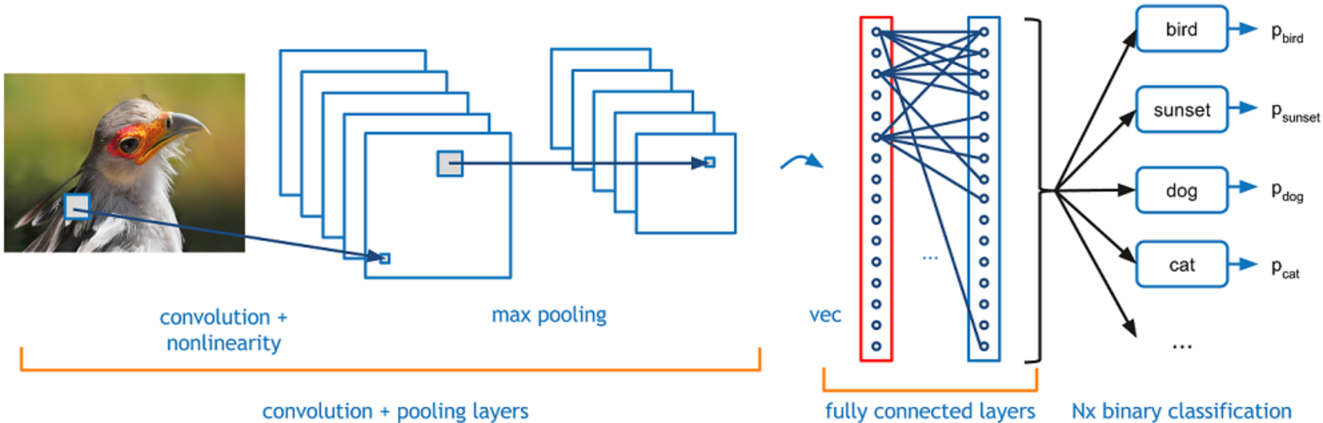
Convolutional Neural Network
Notes:
Computer vision (face recognition), NLP(sentiment analysis based on twitter, forum), game play(DeepBlue, AlphaGo),

Slide 26
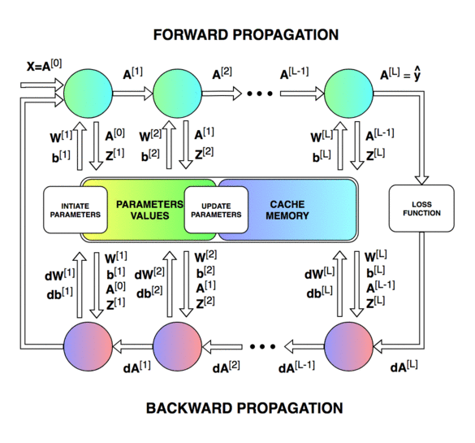
Feed Forward / Back-propagation
Notes:
Computer vision (face recognition), NLP(sentiment analysis based on twitter, forum), game play(DeepBlue, AlphaGo),

Slide 27
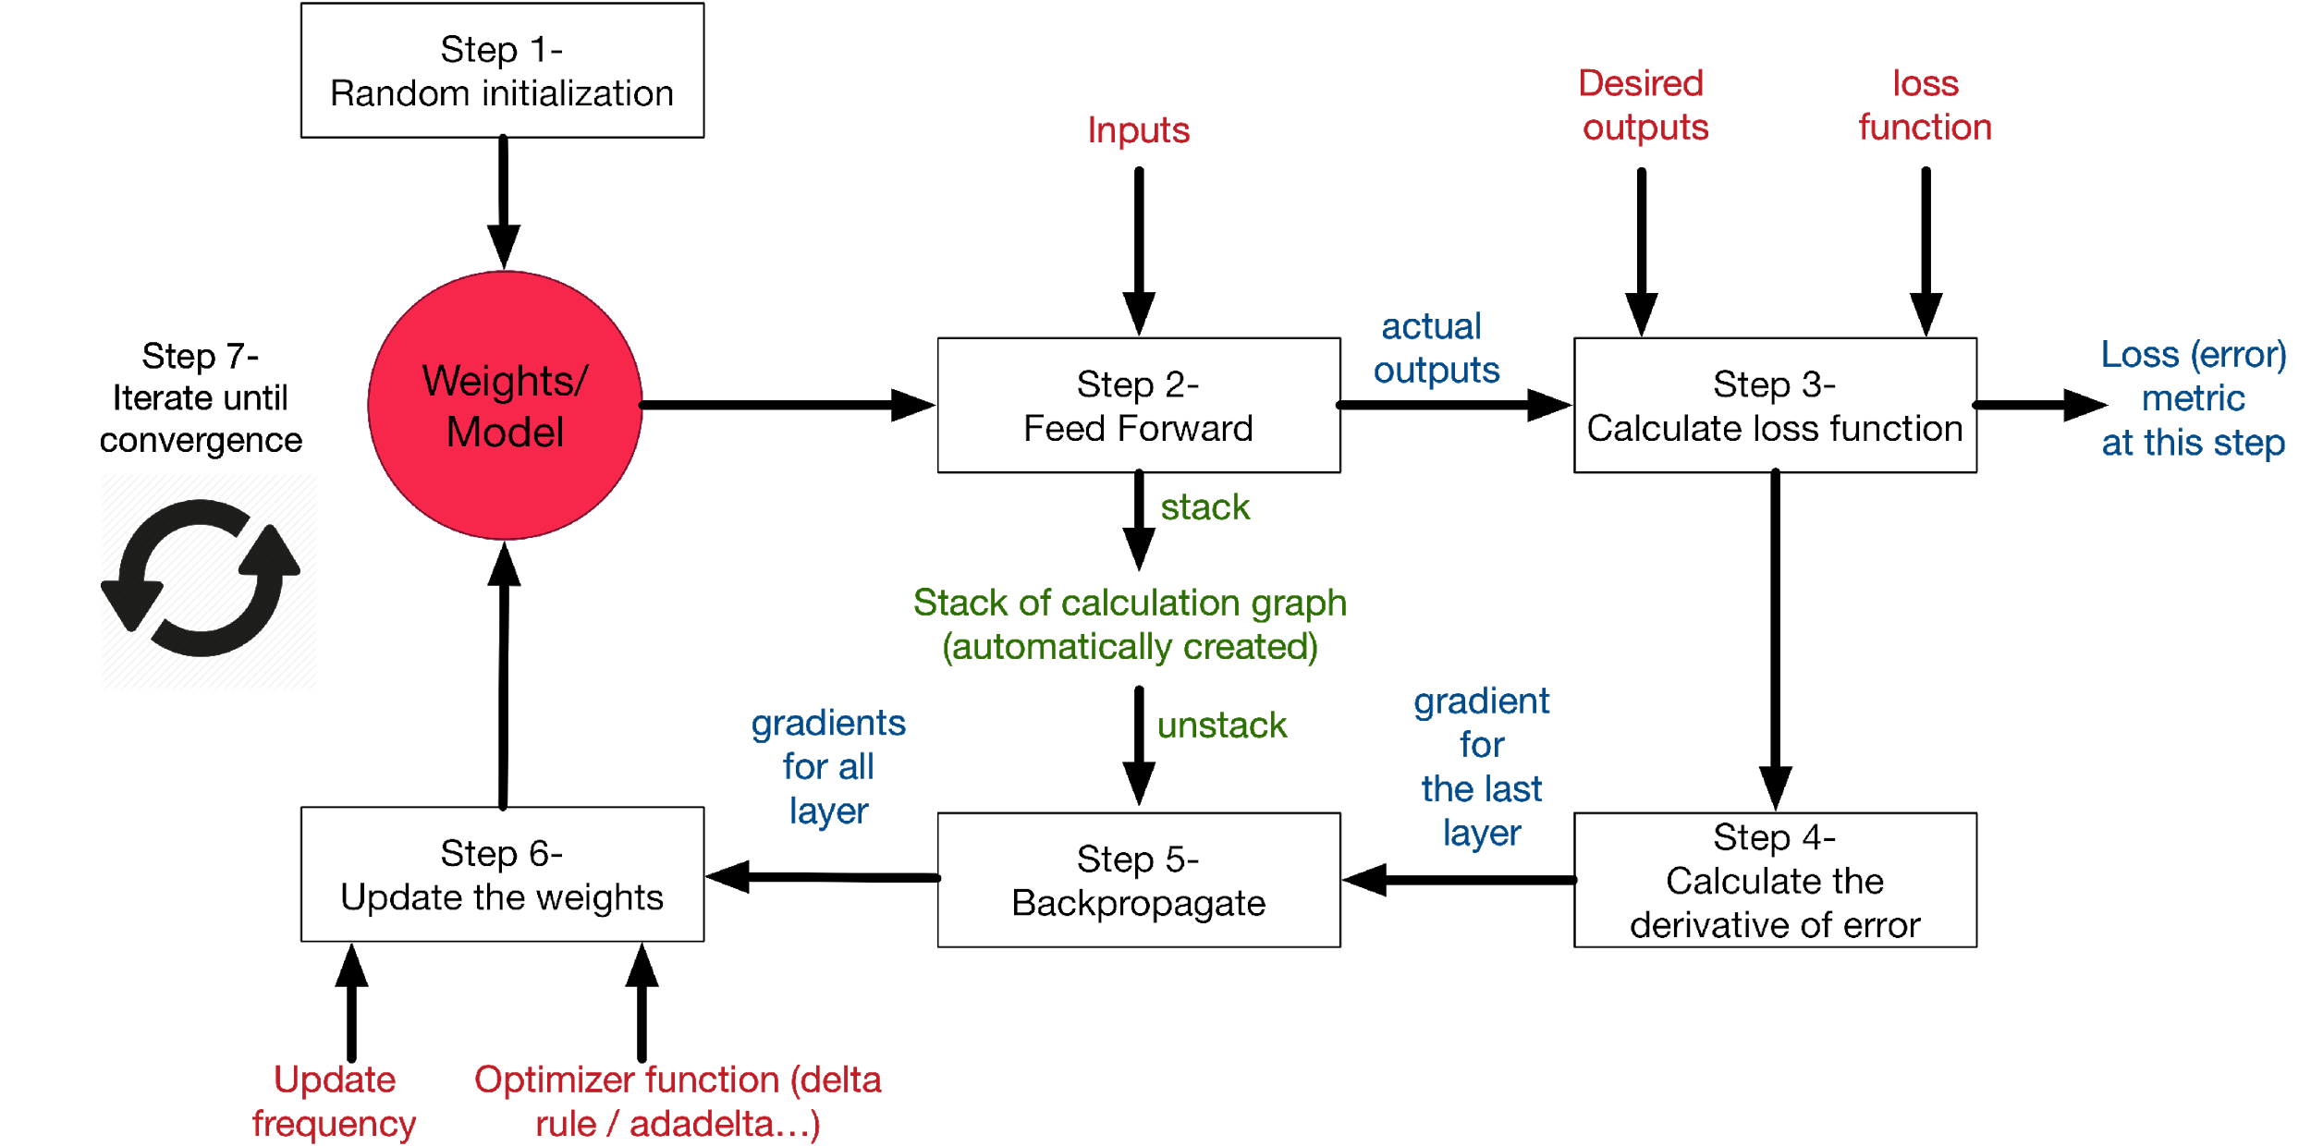
How ANN works?
Gradient Descent
Backward Propagation
Notes:
Computer vision (face recognition), NLP(sentiment analysis based on twitter, forum), game play(DeepBlue, AlphaGo),

Slide 28
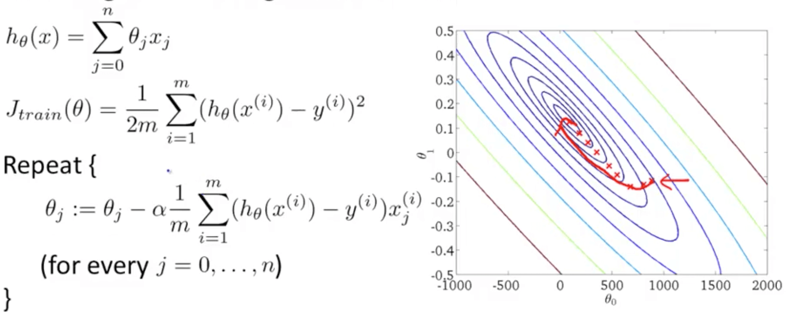
Gradient Descent (Batch, Mini-Batch, Stochastic)
Notes:
Computer vision (face recognition), NLP(sentiment analysis based on twitter, forum), game play(DeepBlue, AlphaGo),

Slide 29
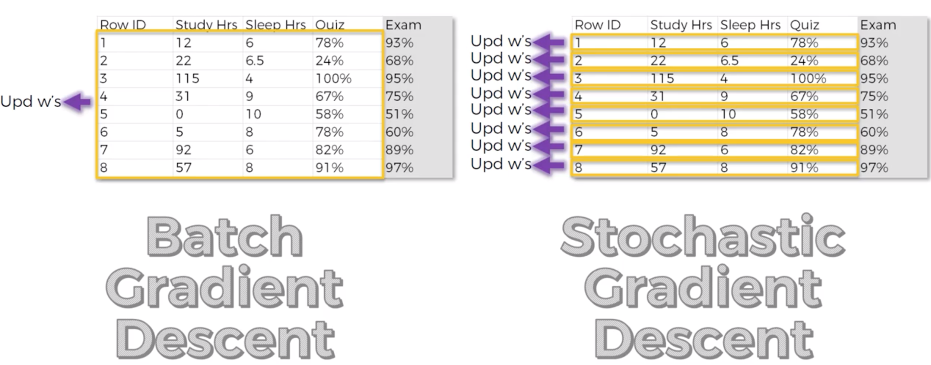
Stochastic Gradient Descent
Notes:
Computer vision (face recognition), NLP(sentiment analysis based on twitter, forum), game play(DeepBlue, AlphaGo),

Slide 30
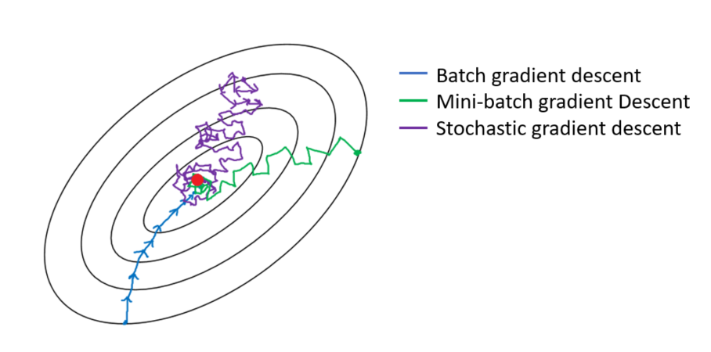
Comparison of 3 Gradient Descent Algorithms
Notes:
Computer vision (face recognition), NLP(sentiment analysis based on twitter, forum), game play(DeepBlue, AlphaGo),

Slide 31
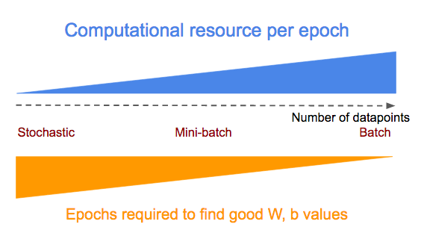
Stochastic Gradient Descent
Notes:
Computer vision (face recognition), NLP(sentiment analysis based on twitter, forum), game play(DeepBlue, AlphaGo),

Slide 32
Deep Learning Libraries
TensorFlow
The most famous library used in production for deep learning models
Open sourced by Google
Not that easy to use
Keras
A high level API built on top of various low level open source (famous) libraries, such as, TensorFlow, Theano (University of Montreal), Microsoft Cognitive Toolkit (CNTK)
Open sourced by Google
User-friendly, modular and extensible
Easier to use as compared to TensorFlow
Now TensorFlow library itself includes Keras Package
PyTorch
Open sourced by Facebook
Caffe
Open sourced by University of California, Berkeley
Notes:
Computer vision (face recognition), NLP(sentiment analysis based on twitter, forum), game play(DeepBlue, AlphaGo),

